Slide 1
RESEARCH WEBS
ENVIRONMENT and ICONIC DESIGNS
USING TECHNOLOGYSTUDENT.COM TO FIND INFORMATION
To help you ﬁnd the information you need, use the ‘search’ function at the bottom of any page of technologystudent.com. The majority of the answers will be found on this website.
For any other information, use a search engine such as Google.
HELPFUL TIP
When using the search function, at the bottom of each page of technologystudent.com, select this option.
WORLD ASSOCIATION OF TECHNOLOGY TEACHERS
https://www.facebook.com/groups/254963448192823/
www.technologystudent.com © 2020 V.Ryan © 2020

Slide 2
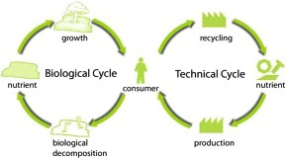
REVISION WEB - KEY ENVIRONMENTAL TERMS / PHRASES
WORLD ASSOCIATION OF TECHNOLOGY TEACHERS https://www.facebook.com/groups/254963448192823/
www.technologystudent.com © 2017 V.Ryan © 2017
RESEARCH EACH OF THE KEY WORDS/PHRASES AND WRITE FACTS ON THE REVISION WEB. ADD A SMALL IMAGE(S) FOR EACH OF THE WORDS/PHRASES. AN EXAMPLE HAS BEEN COMPLETED FOR YOU.
GREEN TECHNOLOGY
UPCYCLING
DOWNCYCLING
RECYCLING
LIFE CYCLE ANALYSIS
GLOBAL WARMING
(LCA)
RAW MATERIALS
SUSTAINABILITY
DISASSEMBLY
CRADLE TO CRADLE®
SUSTAINABILITY
LIFE CYCLE ENERGY ANALYSIS
CLOSED LOOP RECYCLING
BIODEGRADABLE

Slide 3
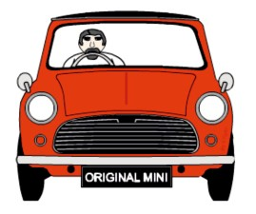
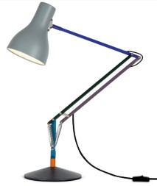
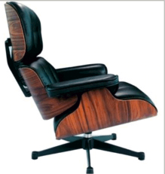
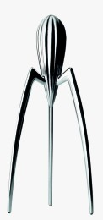
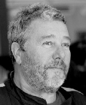
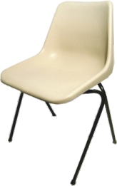
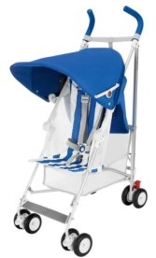
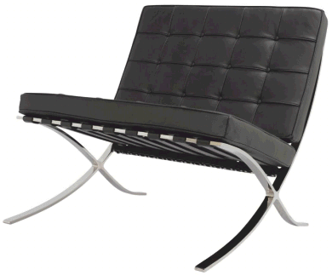
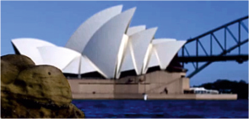
REVISION WEB - ICONIC DESIGNS
WORLD ASSOCIATION OF TECHNOLOGY TEACHERS https://www.facebook.com/groups/254963448192823/
www.technologystudent.com © 2017 V.Ryan © 2017
RESEARCH EACH OF THE ICONIC DESIGNS AND WRITE FACTS ON THE REVISION WEB. ADD A SMALL IMAGE(S) FOR EACH OF THE WORDS/PHRASES. AN EXAMPLE HAS BEEN COMPLETED FOR YOU.
AUSTIN MINI
ANGLEPOISE ® LAMP - 1932
PHILIPPE STARCK
FUTURISTIC DESIGN
EAMES LOUNGE CHAIR
ALESSI BRAND
1990
JUICY SALIF LEMON SQUEEZER
POLYPROP CHAIR
SPITFIRE
BARCELONA CHAIR
MACLAREN B-01 BUGGY
SYDNEY OPERA HOUSE

